Slide 1

ECE 603 Probability and Random Processes
Lessons 10-13
Chapter 5
Joint Distributions
Notes:
Now: Slides with Annotation
Next: Slides with Annotation
*****Preparation Notes*****
Students taking this course should already have covered linear algebra elsewhere.
We will use linear algebra extensively in this course.

Slide 2
Objectives
Explore tools for studying joint distributions of random variables.
Compare joint distributions of discrete random variables with continuous random variables.
Notes:
Now: Slides with Annotation
Next: Slides with Annotation

Slide 3
Rationale
If you were to examine the population of your community, you might notice that each household has a different number of people. Each of those household members has a different age, a different income, a different number of hobbies, etc.
Each of these results is a random variable. In this Lesson, you explore the concept of comparing two or more random variables, because you grasp comparing two, the extension to n random variables is straightforward.
Notes:
Now: Slides with Annotation
Next: Slides with Annotation

Slide 4
Prior Learning
Basic Concepts
Counting Methods
Random Variables
Access to the online textbook: https://www.probabilitycourse.com/
Notes:
Now: Slides with Annotation
Next: Slides with Annotation

Slide 5


Joint Probability Mass Function (PMF)
PMF:
Joint Probability Mass Function (PMF) for and :
Notes:
Now: Slides with Annotation
Next: Slides with Annotation

Slide 6

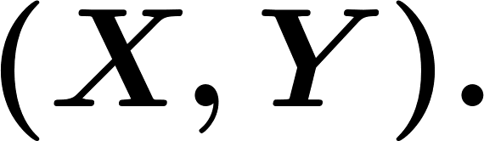

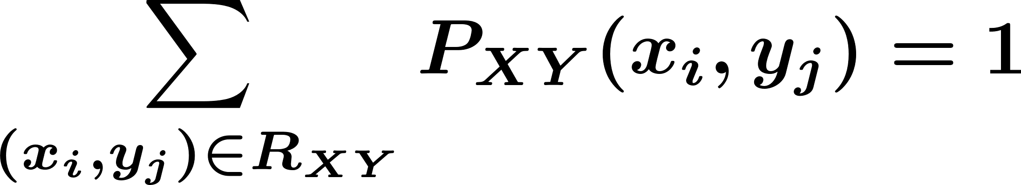
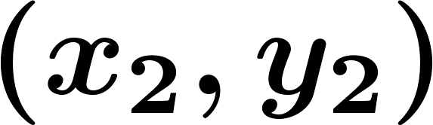
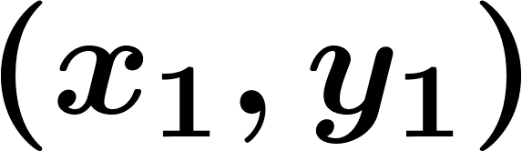

Joint Probability Mass Function (PMF)
all possible value for
Notes:
Now: Slides with Annotation
Next: Slides with Annotation

Slide 7
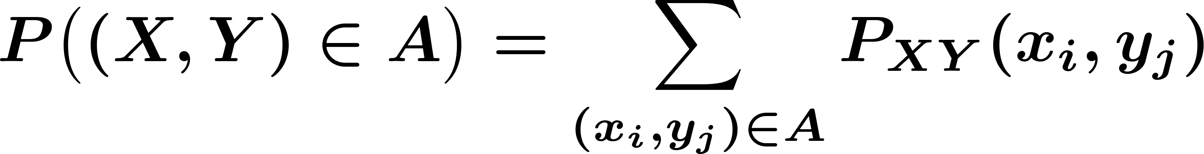

Joint Probability Mass Function (PMF)
Notes:
Now: Slides with Annotation
Next: Slides with Annotation

Slide 8
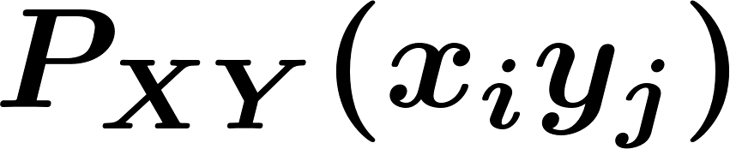
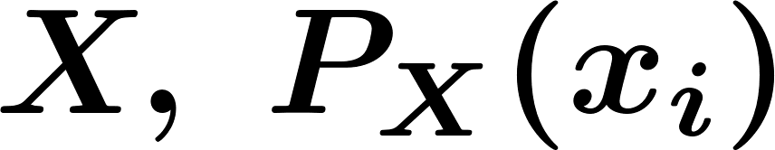
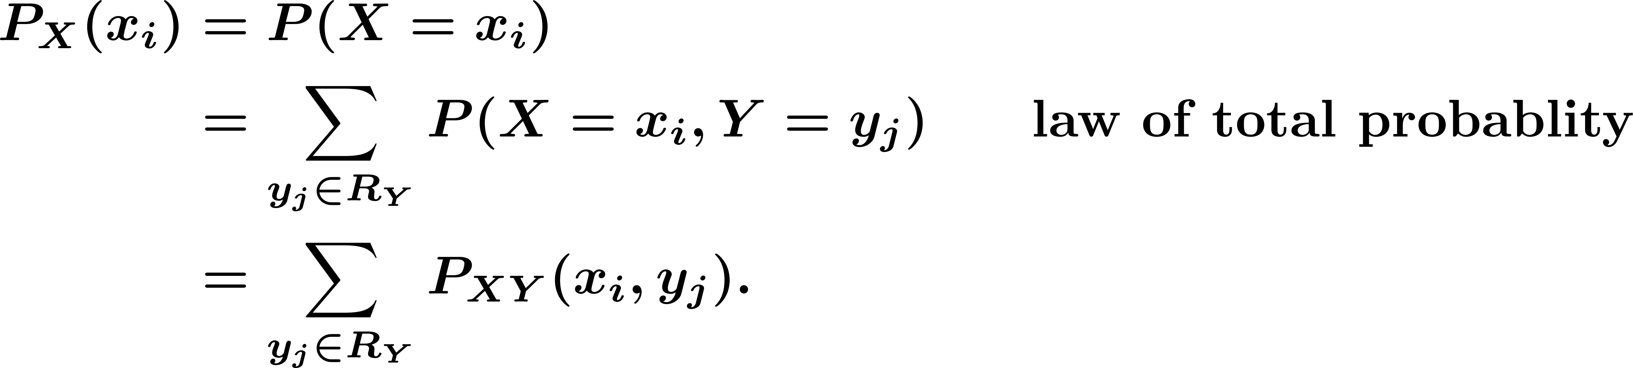
Joint Probability Mass Function (PMF)
Marginal PMFs
I have , how do I find PMF of ?
Notes:
Now: Slides with Annotation
Next: Slides with Annotation

Slide 9
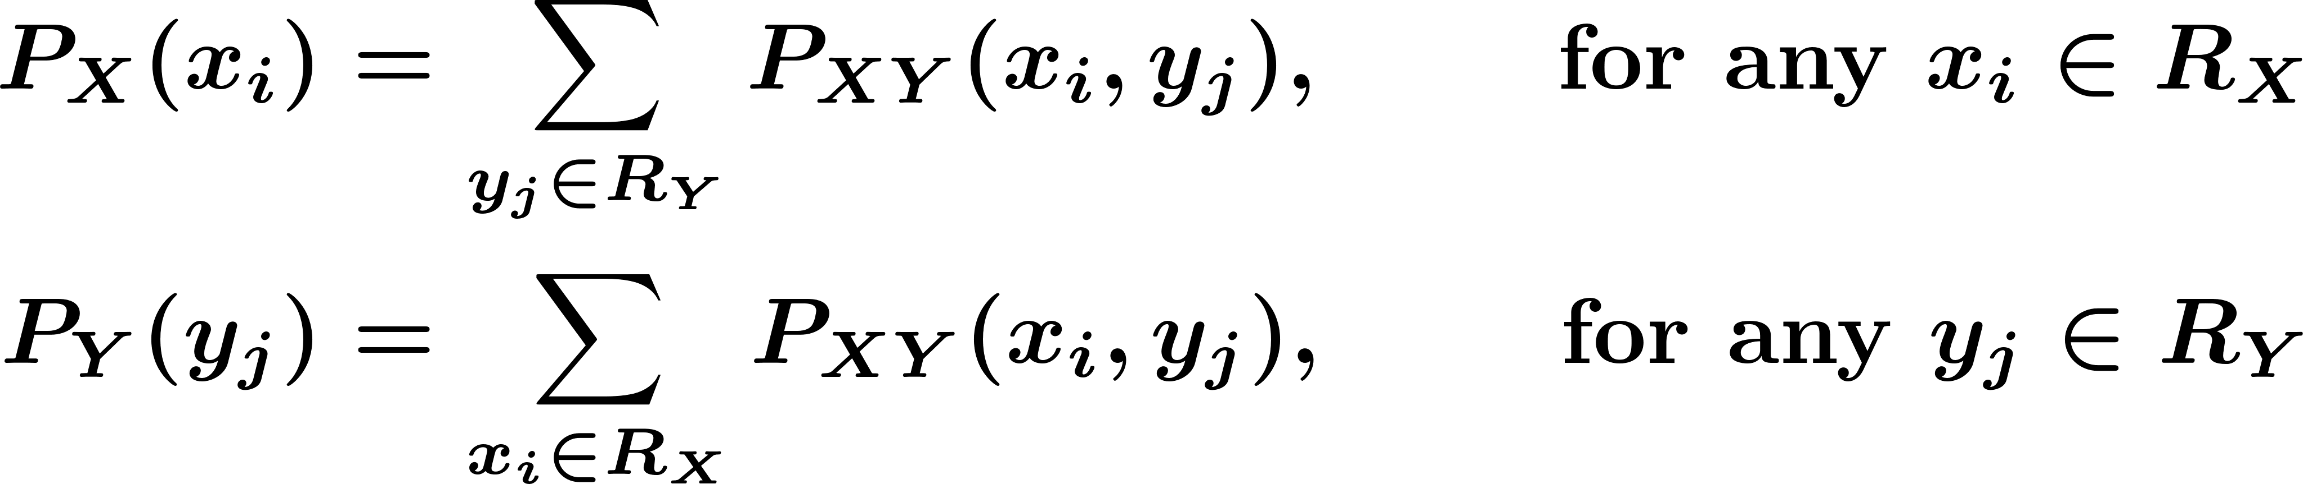
Joint Probability Mass Function (PMF)
Marginal PMFs
Notes:
Now: Slides with Annotation
Next: Slides with Annotation

Slide 10




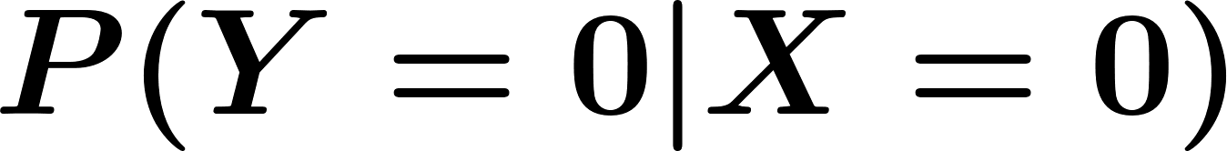






Joint Probability Mass Function (PMF)
Example. Consider two random variables and with joint PMF given in Table.
Find the marginal PMFs of and .
Find .
Are and independent?
Notes:
Now: Slides with Annotation
Next: Slides with Annotation

Slide 11
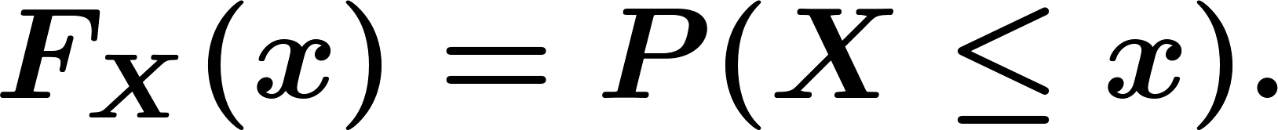
Joint Cumulative Distributive Function (CDF)
Remember that, for a random variable , we define the CDF as
The joint cumulative distribution function of two random variables
and
Notes:
Now: Slides with Annotation
Next: Slides with Annotation

Slide 12
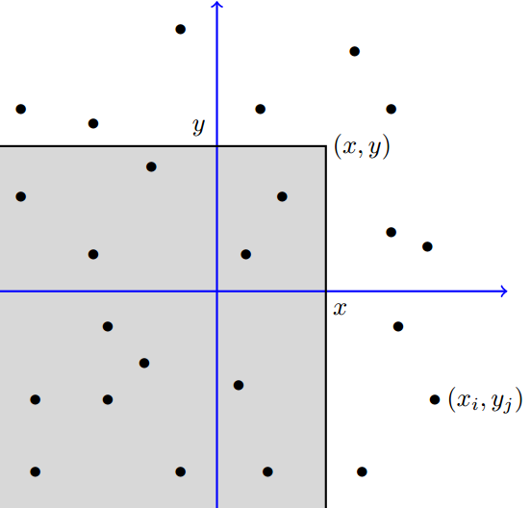
Joint Cumulative Distributive Function (CDF)
Notes:
Now: Slides with Annotation
Next: Slides with Annotation

Slide 13
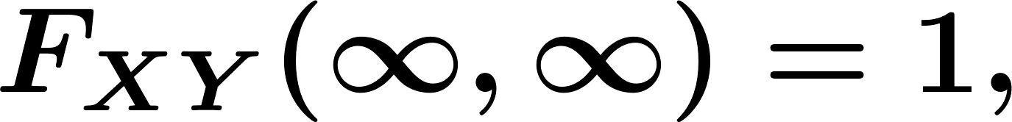
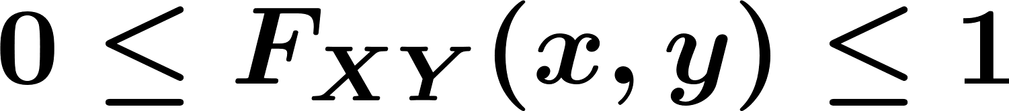
Joint Cumulative Distributive Function (CDF)
Marginal CDFs of and :
Notes:
Now: Slides with Annotation
Next: Slides with Annotation

Slide 14
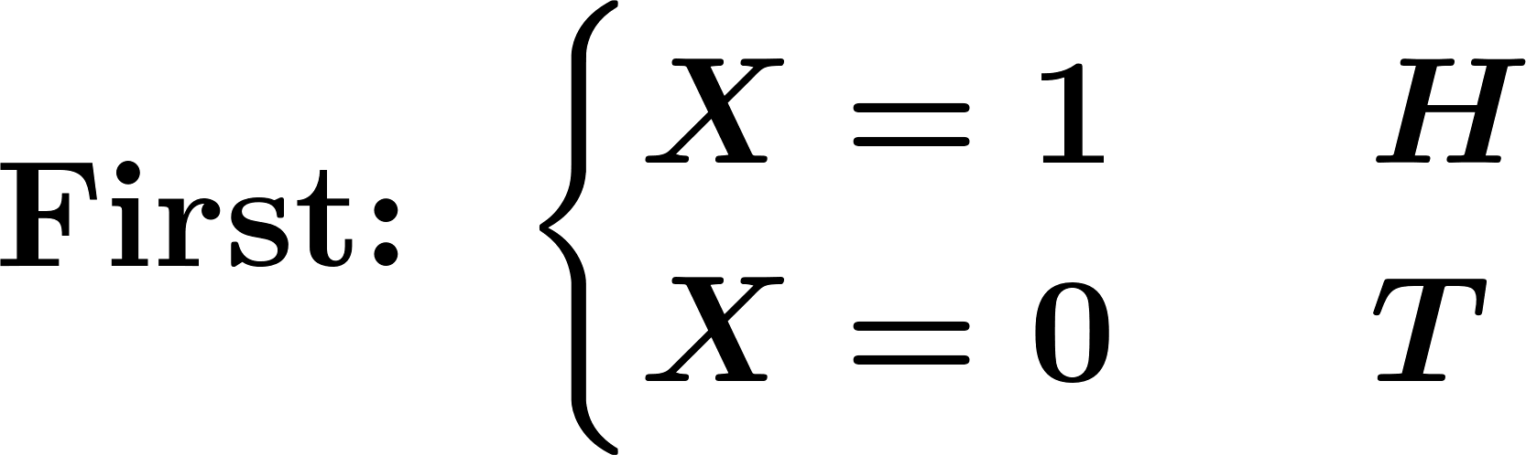
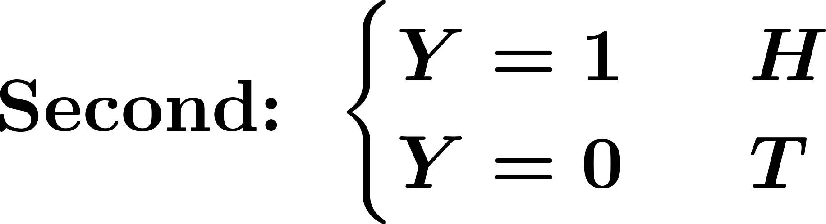
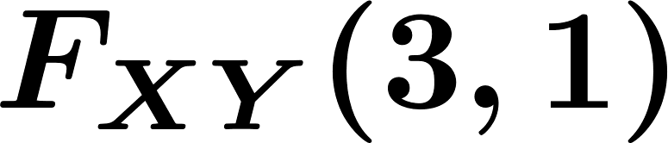
Joint Cumulative Distributive Function (CDF)
Example. Toss a fair coin twice,
and are independent. Find .
Notes:
Now: Slides with Annotation
Next: Slides with Annotation

Slide 15
Joint Cumulative Distributive Function (CDF)
Two discrete random variables and are independent if
Equivalently, and are independent if
Notes:
Now: Slides with Annotation
Next: Slides with Annotation

Slide 16
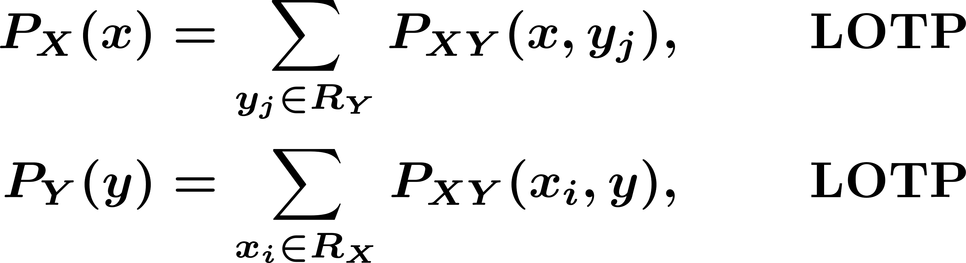
Joint Cumulative Distributive Function (CDF)
So far:
Joint PMF
all possible value for
Marginal PMFs
Notes:
Now: Slides with Annotation
Next: Slides with Annotation

Slide 17
Joint Cumulative Distributive Function (CDF)
Joint CDF:
Remember:
Notes:
Now: Slides with Annotation
Next: Slides with Annotation

Slide 18
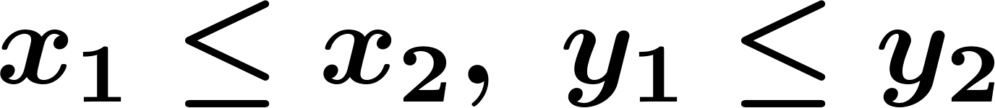
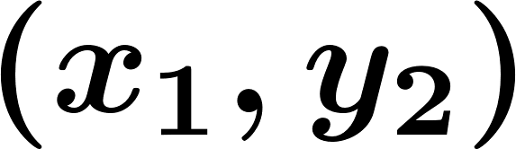
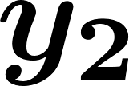
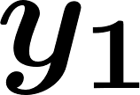
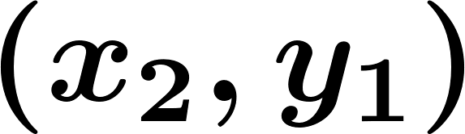
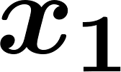

Joint Cumulative Distributive Function (CDF)
Lemma. For two random variables and , and real numbers
, we have
Notes:
Now: Slides with Annotation
Next: Slides with Annotation

Slide 19
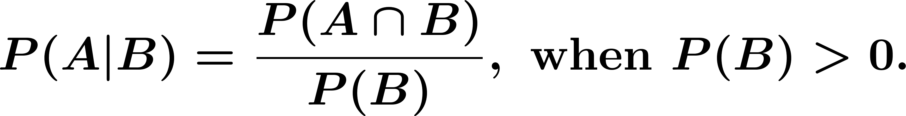
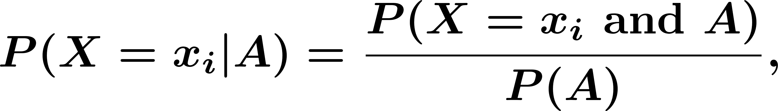
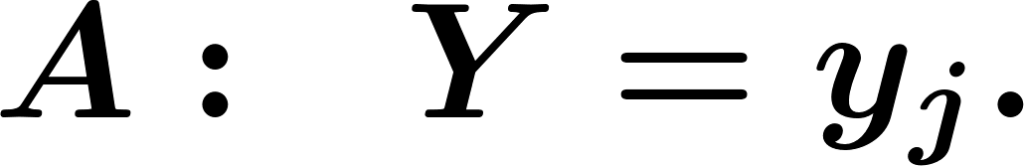
Conditioning and Independence
Conditioning:
For example
Notes:
Now: Slides with Annotation
Next: Slides with Annotation

Slide 20
Conditioning and Independence
PMF:
Conditional PMF:
Conditional CDF:
Notes:
Now: Slides with Annotation
Next: Slides with Annotation

Slide 21
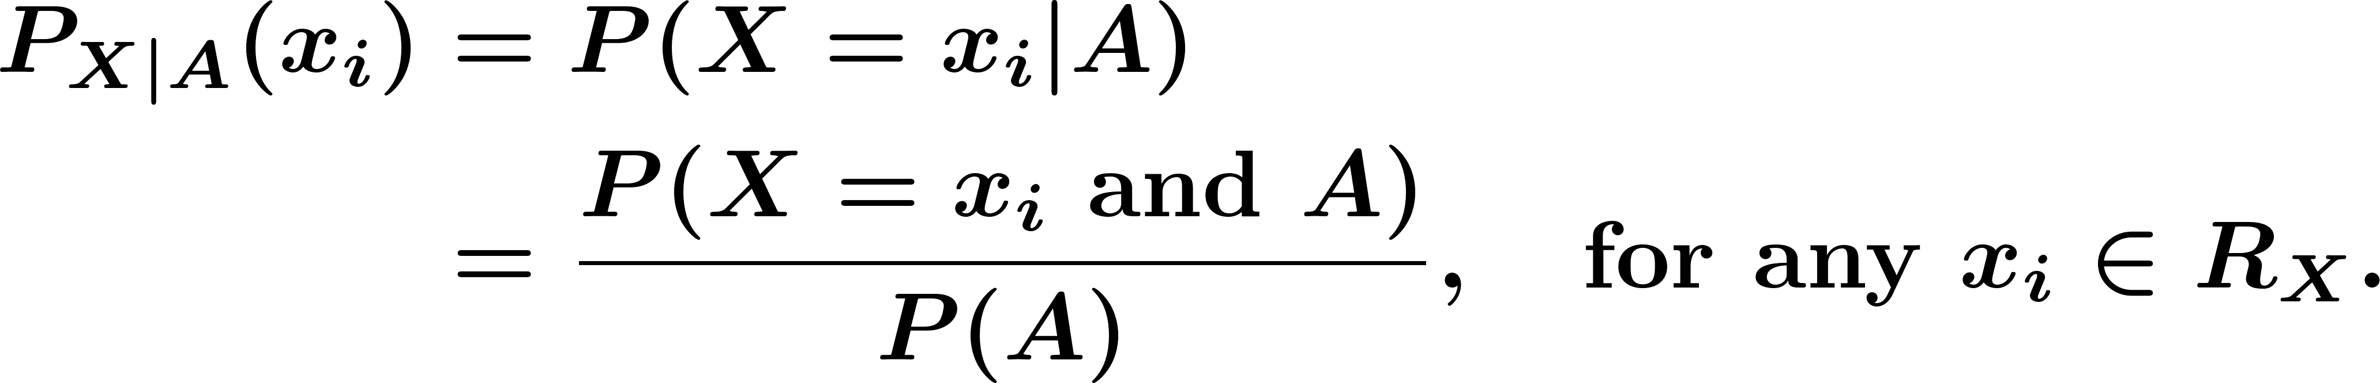
Conditioning and Independence
Conditional PMF and CDF:
For a discrete random variable and event , the conditional PMF of given is defined as
Similarly, we define the conditional CDF of given as
Notes:
Now: Slides with Annotation
Next: Slides with Annotation

Slide 22

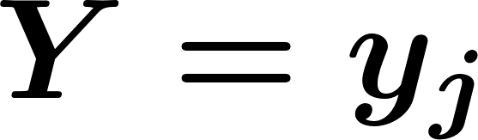
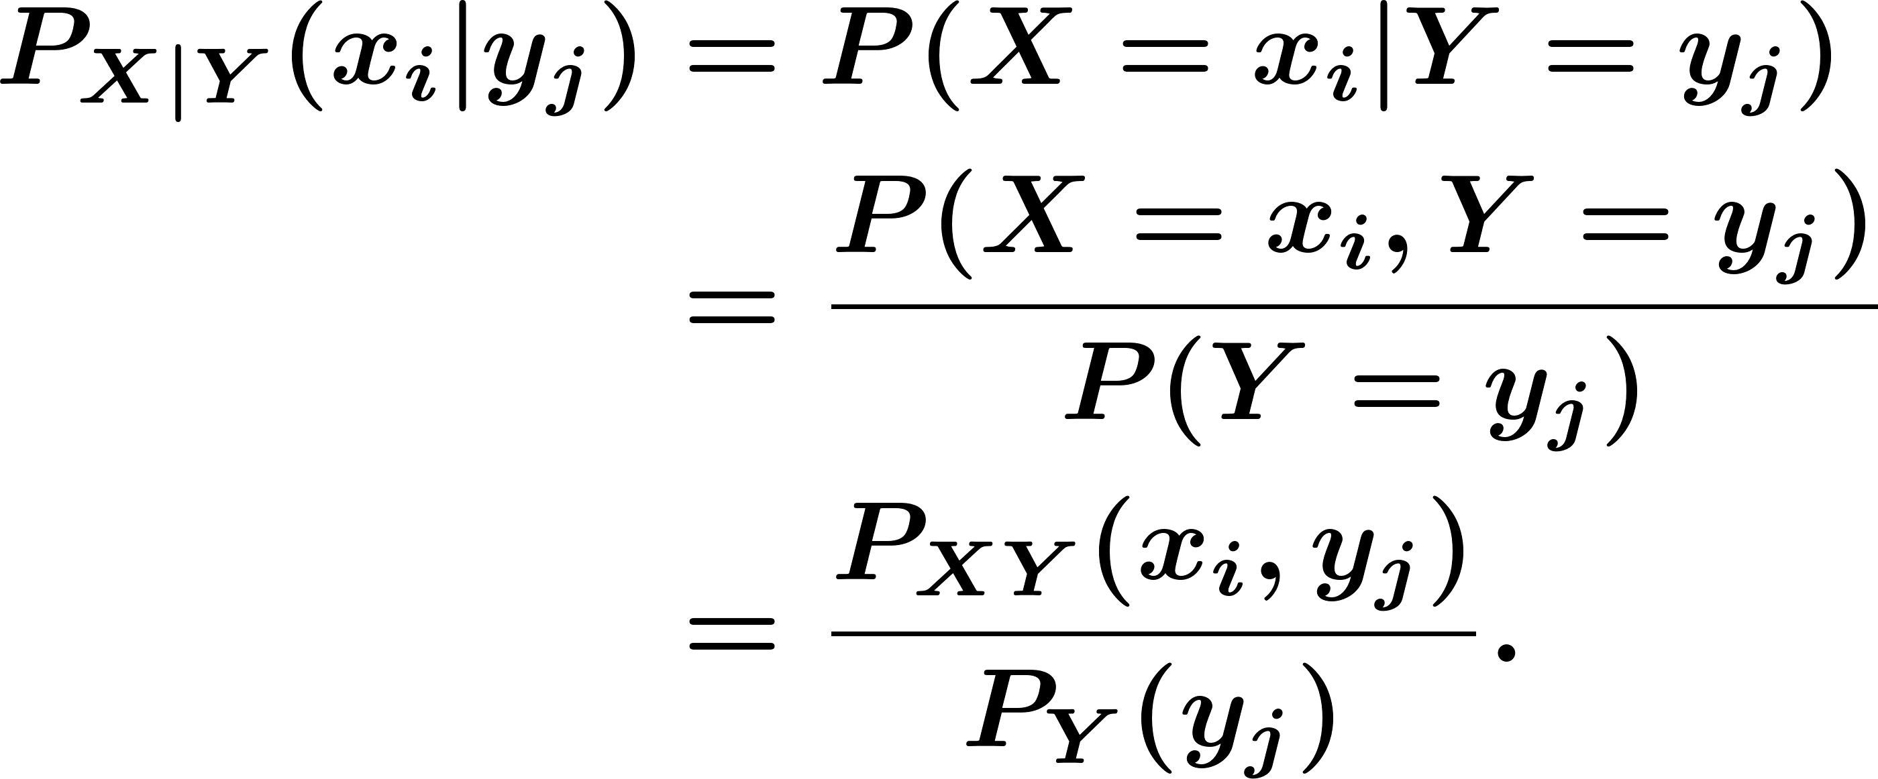
Conditioning and Independence
Let
Conditional PMF of given :
Notes:
Now: Slides with Annotation
Next: Slides with Annotation

Slide 23
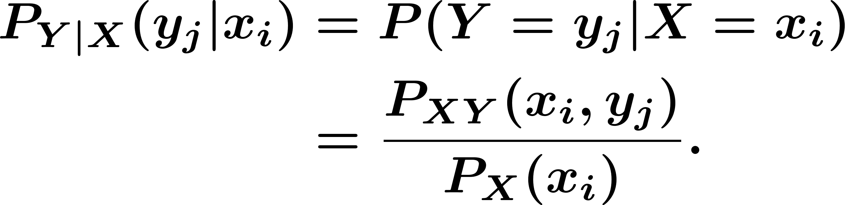
Conditioning and Independence
Similarly, we can define the conditional probability of given :
Notes:
Now: Slides with Annotation
Next: Slides with Annotation

Slide 24
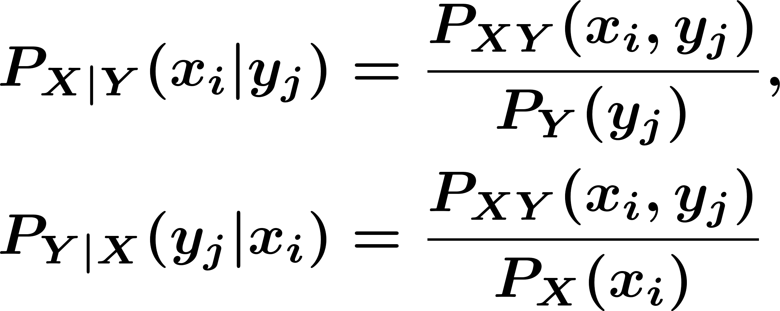
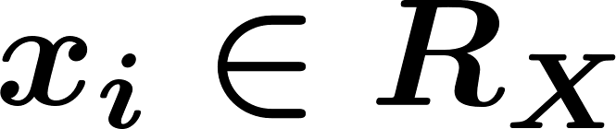
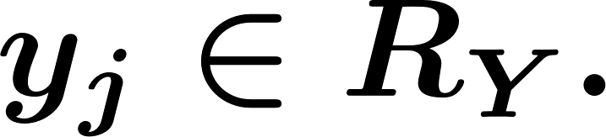
Conditioning and Independence
For discrete random variables and , the conditional PMFs of given and vice versa are defined as
for any and
Notes:
Now: Slides with Annotation
Next: Slides with Annotation

Slide 25
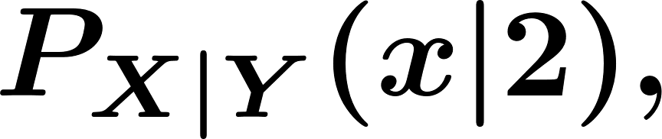





Conditioning and Independence
Example. Consider two random variables and with joint PMF given in the following Table.
Find conditional PMF of given
Notes:
Now: Slides with Annotation
Next: Slides with Annotation

Slide 26
Conditioning and Independence
Independent Random Variables:
Two discrete random variables and are independent if
Equivalently
Equivalently
Notes:
Now: Slides with Annotation
Next: Slides with Annotation

Slide 27
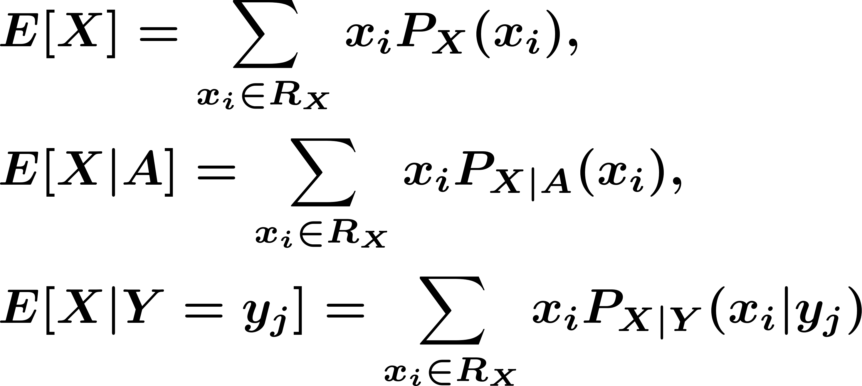
Conditioning and Independence
Conditional Expectation:
Notes:
Now: Slides with Annotation
Next: Slides with Annotation

Slide 28

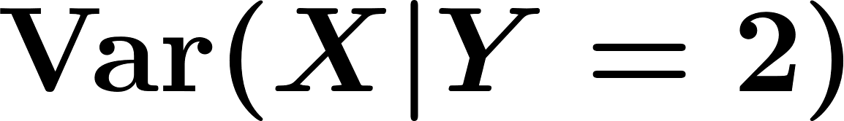
Conditioning and Independence
Example. Consider two random variables and with joint PMF given in Table.
Find and .
Notes:
Now: Slides with Annotation
Next: Slides with Annotation

Slide 29
Conditioning and Independence
Law of Total Probability:
Notes:
Now: Slides with Annotation
Next: Slides with Annotation

Slide 30

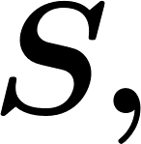
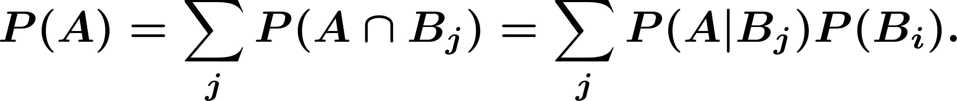
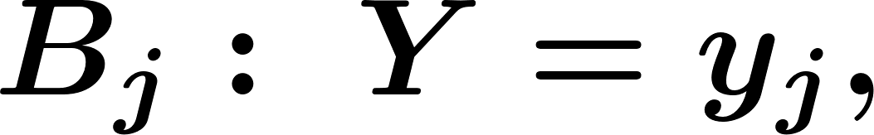
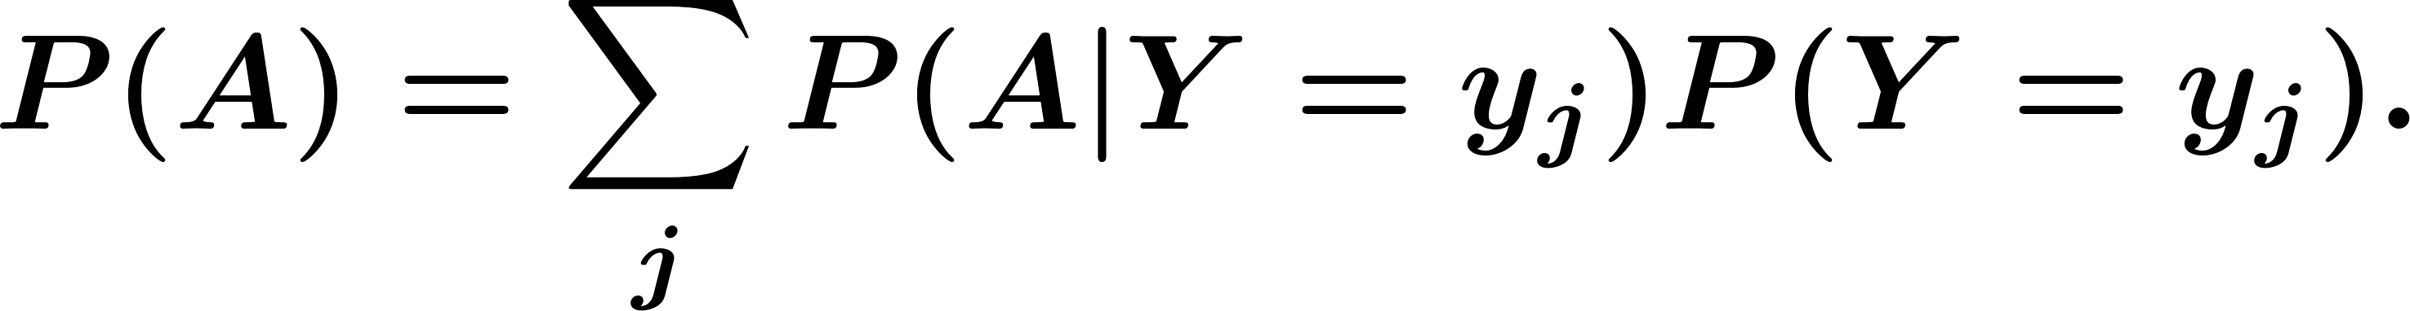
Conditioning and Independence
Law of Total Probability:
If is a partition of the sample space then we have
Notes:
Now: Slides with Annotation
Next: Slides with Annotation

Slide 31
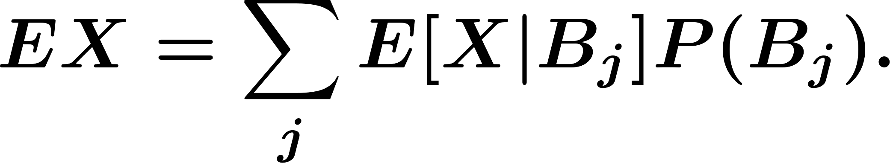
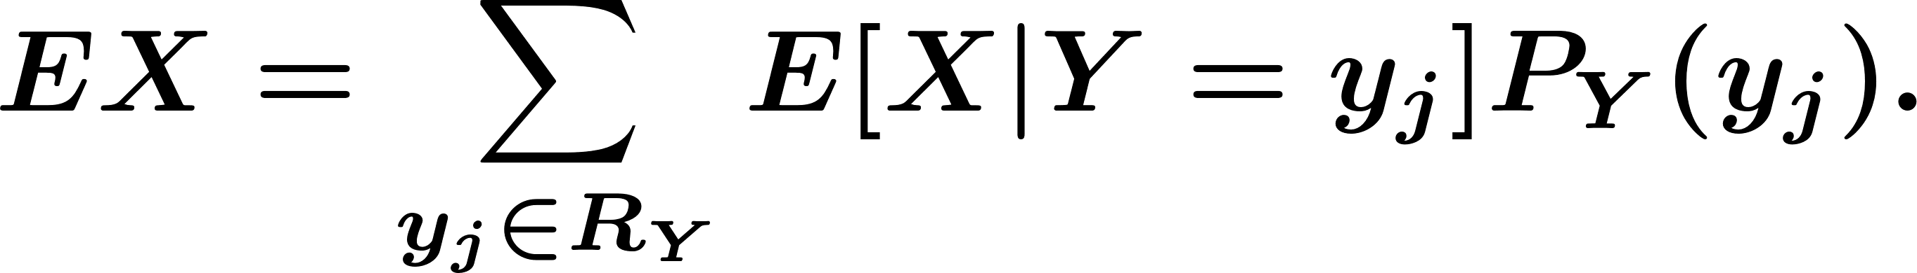
Conditioning and Independence
Law of Total Expectation:
If is a partition of the sample space then we have
Notes:
Now: Slides with Annotation
Next: Slides with Annotation

Slide 32
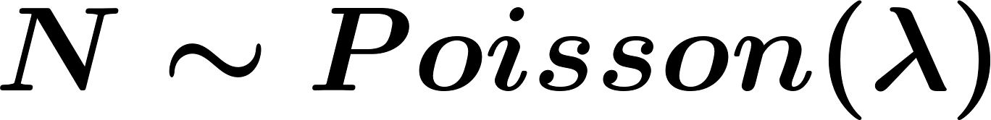
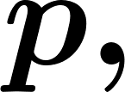


Orchestrated Conversation: Conditioning and Independence
Example. Suppose that the number of customers visiting a fast food restaurant in a given day is . Assume that each customer purchases a drink with probability independently from other customers and independently from the value of . Let be the number of customers who purchase drinks. Find .
Notes:
Now: Slides with Annotation
Next: Slides with Annotation

Slide 33
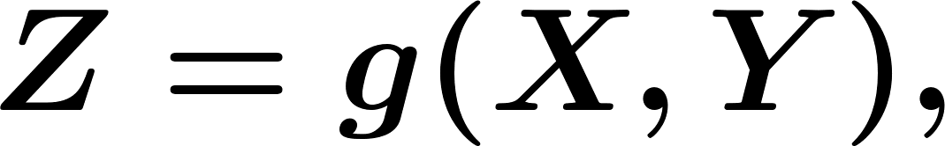

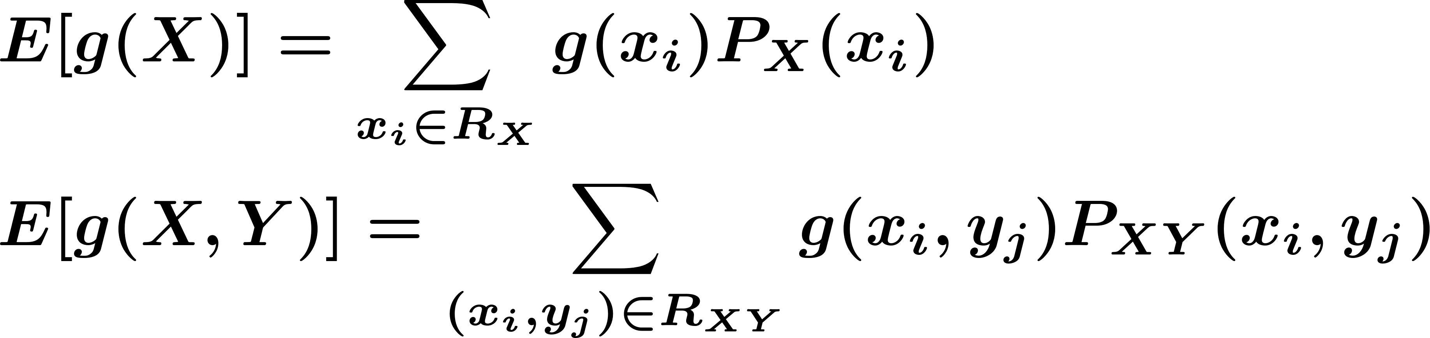
Functions of Two Random Variables
Let and are two random variables, and suppose that
is random variable.
Law of the unconscious statistician (LOTUS) for two discrete random variables:
Notes:
Now: Slides with Annotation
Next: Slides with Annotation

Slide 34
Functions of Two Random Variables
Example. Linearity of Expectation: For two discrete random variables and , show that
Notes:
Now: Slides with Annotation
Next: Slides with Annotation

Slide 35

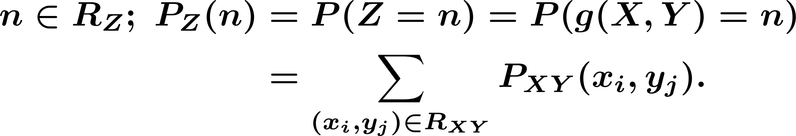
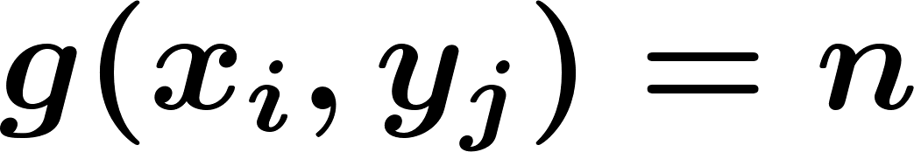
Functions of Two Random Variables
General scenario:
Find PMF of .
For
Notes:
Now: Slides with Annotation
Next: Slides with Annotation

Slide 36
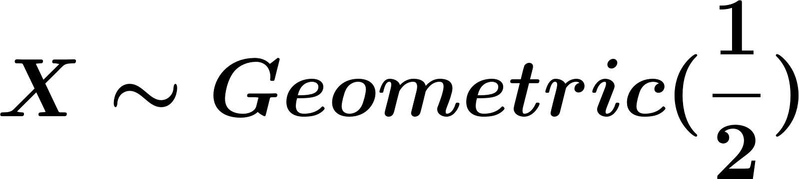


Functions of Two Random Variables
Example. Let and be two independent random variables and . Find PMF of .
Notes:
Now: Slides with Annotation
Next: Slides with Annotation

Slide 37



Conditional Expectation and Variance
Conditional Expectation as a Function of a Random Variable:
Note that depends on the value of , so we can write
Notes:
Now: Slides with Annotation
Next: Slides with Annotation

Slide 38



Conditional Expectation and Variance
Thus, we can think of as a function of the value of the random variable . We then write
If is a random variable with range , then
Notes:
Now: Slides with Annotation
Next: Slides with Annotation

Slide 39




Conditional Expectation and Variance
Example. Consider two random variables and with joint PMF given in the following Table
Find the Marginal PMFs of and .
Find the conditional PMF of given and .
Find the PMF of .
Find , and check that .
Find .
Notes:
Now: Slides with Annotation
Next: Slides with Annotation

Slide 40


Conditional Expectation and Variance
Table. Joint PMF of and in example.
Notes:
Now: Slides with Annotation
Next: Slides with Annotation

Slide 41


Conditional Expectation and Variance
Rule: Taking out what is known.
Proof: Note that is a random variable that is a function of . If then
Notes:
Now: Slides with Annotation
Next: Slides with Annotation

Slide 42


Conditional Expectation and Variance
Iterated Expectations:
Let
Then,
Notes:
Now: Slides with Annotation
Next: Slides with Annotation

Slide 43
Conditional Expectation and Variance
Iterated Expectations:
This is equal to the low of total Expectation.
Notes:
Now: Slides with Annotation
Next: Slides with Annotation

Slide 44
Conditioning and Independence
Example. Suppose that the number of customers visiting a fast food restaurant in a given day is . Assume that each customer purchases a drink with probability independently from other customers and independently from the value of . Let be the number of customers who purchase drinks. Find .
Notes:
Now: Slides with Annotation
Next: Slides with Annotation

Slide 45


Conditional Expectation and Variance
If and are independent random variables, then
Notes:
Now: Slides with Annotation
Next: Slides with Annotation

Slide 46




Conditional Expectation and Variance
Conditional Variance:
Let then
Note that is a function of . We define is a function of . That is, is a random variable whose value equals
Notes:
Now: Slides with Annotation
Next: Slides with Annotation

Slide 47



Conditional Expectation and Variance
Example. Consider two random variables and with joint PMF given in the following Table. Let .
Find the PMF of .
Find .
Check .
Notes:
Now: Slides with Annotation
Next: Slides with Annotation

Slide 48
Conditional Expectation and Variance
Law of Total Variance:
Notes:
Now: Slides with Annotation
Next: Slides with Annotation

Slide 49





Conditional Expectation and Variance
Example. Let be the number of customers that visit a certain store in a given day. Suppose that we know and . Let be the amount that the customer spends on average. We assume ’s are independent of each other and also independent of . We further assume they have the same mean and variance
Notes:
Now: Slides with Annotation
Next: Slides with Annotation

Slide 50



Conditional Expectation and Variance
Let be the store's total sales, i.e.,
Find and .
Notes:
Now: Slides with Annotation
Next: Slides with Annotation

Slide 51


Two Continuous Random Variables
PDF:
Joint PDF:
Notes:
Now: Slides with Annotation
Next: Slides with Annotation

Slide 52


Two Continuous Random Variables
If we choose , then
Notes:
Now: Slides with Annotation
Next: Slides with Annotation

Slide 53




Two Continuous Random Variables
Definition. Two random variables and are jointly continuous if there exists a nonnegative function , such that, for any set , we have
The function is called the joint probability density function (PDF) of
and .
Notes:
Now: Slides with Annotation
Next: Slides with Annotation

Slide 54

Two Continuous Random Variables
CDF:
Joint CDF:
and
Notes:
Now: Slides with Annotation
Next: Slides with Annotation

Slide 55


Two Continuous Random Variables
Notes:
Now: Slides with Annotation
Next: Slides with Annotation

Slide 56



Two Continuous Random Variables
Example. Let and be two random variables with joint PDF given by
Find .
Find .
Notes:
Now: Slides with Annotation
Next: Slides with Annotation

Slide 57

Two Continuous Random Variables
Notes:
Now: Slides with Annotation
Next: Slides with Annotation

Slide 58



Two Continuous Random Variables
The joint cumulative function of two random variables and is defined as
The joint CDF satisfies the following properties:
, for any (marginal CDF of );
, for any (marginal CDF of );
Notes:
Now: Slides with Annotation
Next: Slides with Annotation

Slide 59
Two Continuous Random Variables
if and are independent, then
Notes:
Now: Slides with Annotation
Next: Slides with Annotation

Slide 60


Two Continuous Random Variables
Marginal PDFs:
For discrete random variables:
For continuous random variables:
Notes:
Now: Slides with Annotation
Next: Slides with Annotation

Slide 61



Two Continuous Random Variables
Example. Let and be two random variables with joint PDF given by
Find the marginal PDFs and .
Notes:
Now: Slides with Annotation
Next: Slides with Annotation

Slide 62

Conditioning and Independence
Conditional probability:
conditional CDF:
Notes:
Now: Slides with Annotation
Next: Slides with Annotation

Slide 63


Conditioning and Independence
Example. Let continuous
If
Notes:
Now: Slides with Annotation
Next: Slides with Annotation

Slide 64





Conditioning and Independence
Finally, if , then . Thus, we obtain
Then the conditional PDF of given is given by
Notes:
Now: Slides with Annotation
Next: Slides with Annotation

Slide 65


Conditioning and Independence
In general, for a random variable and an event , we have the following:
Notes:
Now: Slides with Annotation
Next: Slides with Annotation

Slide 66


Conditioning and Independence
Conditioning by Another Random Variable:
For discrete random variables: the conditional PMF of given is given by
Notes:
Now: Slides with Annotation
Next: Slides with Annotation

Slide 67



Conditioning and Independence
For continuous random variables:
The conditional PMF of given is given by
The conditional PMF of given is given by
Notes:
Now: Slides with Annotation
Next: Slides with Annotation

Slide 68





Conditioning and Independence
Example. Choose a point Uniformly at random in the unit disc ,
Find and .
Find .
Find
Notes:
Now: Slides with Annotation
Next: Slides with Annotation

Slide 69

Conditioning and Independence
For two jointly continuous random variables and , we have
Notes:
Now: Slides with Annotation
Next: Slides with Annotation

Slide 70


Summary of Conditioning
Conditional probability:
conditional CDF and PDF given : (e.g., )
Notes:
Now: Slides with Annotation
Next: Slides with Annotation

Slide 71
Summary of Conditioning
In general, for a random variable and an event , we have the following:
Notes:
Now: Slides with Annotation
Next: Slides with Annotation

Slide 72
Summary of Conditioning
Conditioning by Another Random Variable:
For discrete random variables: the conditional PMF of given is given by
Notes:
Now: Slides with Annotation
Next: Slides with Annotation

Slide 73
Summary of Conditioning
For continuous random variables:
The conditional PMF of given is given by
The conditional PMF of given is given by
Notes:
Now: Slides with Annotation
Next: Slides with Annotation

Slide 74

Summary of Conditioning
For two jointly continuous random variables and , we have
Notes:
Now: Slides with Annotation
Next: Slides with Annotation

Slide 75

Conditioning and Independence
Law of Total Probability:
Law of Total Expectation:
Notes:
Now: Slides with Annotation
Next: Slides with Annotation

Slide 76
Conditioning and Independence
Law of Total Variance:
Notes:
Now: Slides with Annotation
Next: Slides with Annotation

Slide 77


Conditioning and Independence
Example. Suppose and given , then
Find
Notes:
Now: Slides with Annotation
Next: Slides with Annotation

Slide 78
Conditioning and Independence
Independent Random Variables:
Discrete:
Continuous:
#:
Notes:
Now: Slides with Annotation
Next: Slides with Annotation

Slide 79

Functions of Two Continuous Random Variables
LOTUS for two continuous random variables:
Notes:
Now: Slides with Annotation
Next: Slides with Annotation

Slide 80


Functions of Two Continuous Random Variables
Example. Let and be two independent random variables, and . Find the CDF and PDF of .
Notes:
Now: Slides with Annotation
Next: Slides with Annotation

Slide 81





Functions of Two Continuous Random Variables
Theorem. Let and be two jointly continuous random variables. Let
, where is a continuous one-to-one (invertible) function with continuous partial derivatives. Let , i.e., . Then and are jointly continuous and their joint PDF, , for is given by
Notes:
Now: Slides with Annotation
Next: Slides with Annotation

Slide 82



Functions of Two Continuous Random Variables
Where is the Jacobian of defined by
Notes:
Now: Slides with Annotation
Next: Slides with Annotation

Slide 83


Functions of Two Continuous Random Variables
Example.
Let and be two independent random variables with PDF defined
Find and .
Notes:
Now: Slides with Annotation
Next: Slides with Annotation

Slide 84

Functions of Two Continuous Random Variables
If and are two jointly continuous random variables and , then
If and are also independent, then
Notes:
Now: Slides with Annotation
Next: Slides with Annotation

Slide 85
Summary of Independence
Two continuous random variables and are independent if
Notes:
Now: Slides with Annotation
Next: Slides with Annotation

Slide 86
Conditioning and Independence
Example. Determine whether and are independent:
Notes:
Now: Slides with Annotation
Next: Slides with Annotation

Slide 87


Conditioning and Independence
Two continuous random variables and are independent, then we have
Notes:
Now: Slides with Annotation
Next: Slides with Annotation

Slide 88
Conditioning and Independence
More generally: and independent
Notes:
Now: Slides with Annotation
Next: Slides with Annotation

Slide 89

Covariance and Correlation
The covariance between and is defined as
Proof:
Notes:
Now: Slides with Annotation
Next: Slides with Annotation

Slide 90



Covariance and Correlation
Example. Suppose and given , is
Find
Notes:
Now: Slides with Annotation
Next: Slides with Annotation

Slide 91

Covariance and Correlation
Lemma. The covariance has the following properties:
independent:
Notes:
Now: Slides with Annotation
Next: Slides with Annotation

Slide 92
Covariance and Correlation
Notes:
Now: Slides with Annotation
Next: Slides with Annotation

Slide 93

Covariance and Correlation
More generally
Notes:
Now: Slides with Annotation
Next: Slides with Annotation

Slide 94

Covariance and Correlation
Variance of a sum:
If , then
Notes:
Now: Slides with Annotation
Next: Slides with Annotation

Slide 95

Covariance and Correlation
More generally, for , we conclude:
Notes:
Now: Slides with Annotation
Next: Slides with Annotation

Slide 96

Covariance and Correlation
Correlation Coefficient:
Notes:
Now: Slides with Annotation
Next: Slides with Annotation

Slide 97


Covariance and Correlation
Properties of the correlation coefficient:
Notes:
Now: Slides with Annotation
Next: Slides with Annotation

Slide 98



Covariance and Correlation
Definition. Consider two random variables and :
If , we say that and are uncorrelated.
If , we say that and are positively correlated.
If , we say that and are negatively correlated.
Notes:
Now: Slides with Annotation
Next: Slides with Annotation

Slide 99


Bivariate Normal Distribution
Definition. Two random variables and are said to be bivariate normal, or jointly normal, if has a normal distribution for all
Notes:
Now: Slides with Annotation
Next: Slides with Annotation

Slide 100

Bivariate Normal Distribution
Example. Let and be two bivariate normal random variables, i.e.,
If , find the PDF of .
Notes:
Now: Slides with Annotation
Next: Slides with Annotation

Slide 101




Bivariate Normal Distribution
Definition. Two random variables and are said to have a bivariate normal distribution with parameters and , if their joint PDF is given by
Where and are all constants.
Notes:
Now: Slides with Annotation
Next: Slides with Annotation

Slide 102


Bivariate Normal Distribution
If ( are uncorrelated) :
Function of
Function of
Notes:
Now: Slides with Annotation
Next: Slides with Annotation

Slide 103
Bivariate Normal Distribution
Theorem. If and are bivariate normal and uncorrelated, then they are independent.
Notes:
Now: Slides with Annotation
Next: Slides with Annotation

Slide 104

Bivariate Normal Distribution
Example. Let and be two bivariate normal random variables. Find the conditional PDF of
Notes:
Now: Slides with Annotation
Next: Slides with Annotation

Slide 105


Bivariate Normal Distribution
Theorem. Suppose and are jointly normal random variables with parameters and . Then, given is normally distributed with
Notes:
Now: Slides with Annotation
Next: Slides with Annotation

Slide 106





Bivariate Normal Distribution
Example. Let and be two bivariate normal random variables and uncorrelated,
We define
Find and
Find
Find
Find
Notes:
Now: Slides with Annotation
Next: Slides with Annotation

Slide 107
Post-work for Lesson
Complete homework assignment for Lessons 10-13:
HW#6 and HW#7
Go to the online classroom for details.
Notes:
Now: Slides with Annotation
Next: Slides with Annotation

Slide 108
To Prepare for the Next Lesson
Read Chapter 6 in your online textbook:
https://www.probabilitycourse.com/chapter6/6_0_0_intro.php
Complete the Pre-work for Lessons 14-16.
Visit the online classroom for details.
Notes:
Now: Slides with Annotation

